Slide 1
New English File
Intermediate
Session 9

Slide 2
Unit 7
Part A
1 GRAMMAR

Slide 3
Third conditional
third conditional sentences: If+ had + past participle, would + have + past participle.
If I’d known about the meeting, I would have gone.
If I hadn’t gone to that party, I wouldn’t have met my wife.
You wouldn’t have been late if you’d got up earlier.
We would have arrived at 6.00 if we hadn’t got lost.
The contraction of had is ’d.
Use third conditional sentences to talk about a hypothetical / imaginary situation in the past (which didn't happen) and its consequence. Compare:
Yesterday I got up late and missed my train (= the real situation).
If I hadn’t got up late yesterday, I wouldn’t have missed my train (= the hypothetical / imaginary situation).
To make a third conditional, use if+ past perfect and would have+ past participle.

Slide 4
G
H
K
C
J
A
E
D
B
F

Slide 5
Complete the third conditional sentences with the correct form of the verbs.
If you hadn’t helped me, I wouldn’t have finished on time, (not help, not finish)
We _______________ if our best player __________injured, (win, not be)
If she ________ he was so mean, she _________________ him. (know, not marry)
I _____________you some money if you _________me. (lend, ask)
If we ________ more time, we _____________ another day in London.(have, spend)
I ________________ to help you if you _______me about it earlier. (be able, tell)
If you ____________me yesterday, I _________________ my plans. (ask, change)
You _______________ the weekend if you ___________with us. (enjoy, come)
would have won
hadn’t been
had known
wouldn’t have married
would have lent
had asked
had had
would have spent
would have been able
had told
had asked
wouldn’t have changed
would have enjoyed
had come

Slide 6
Unit 7
Part A
2 READING

Slide 7
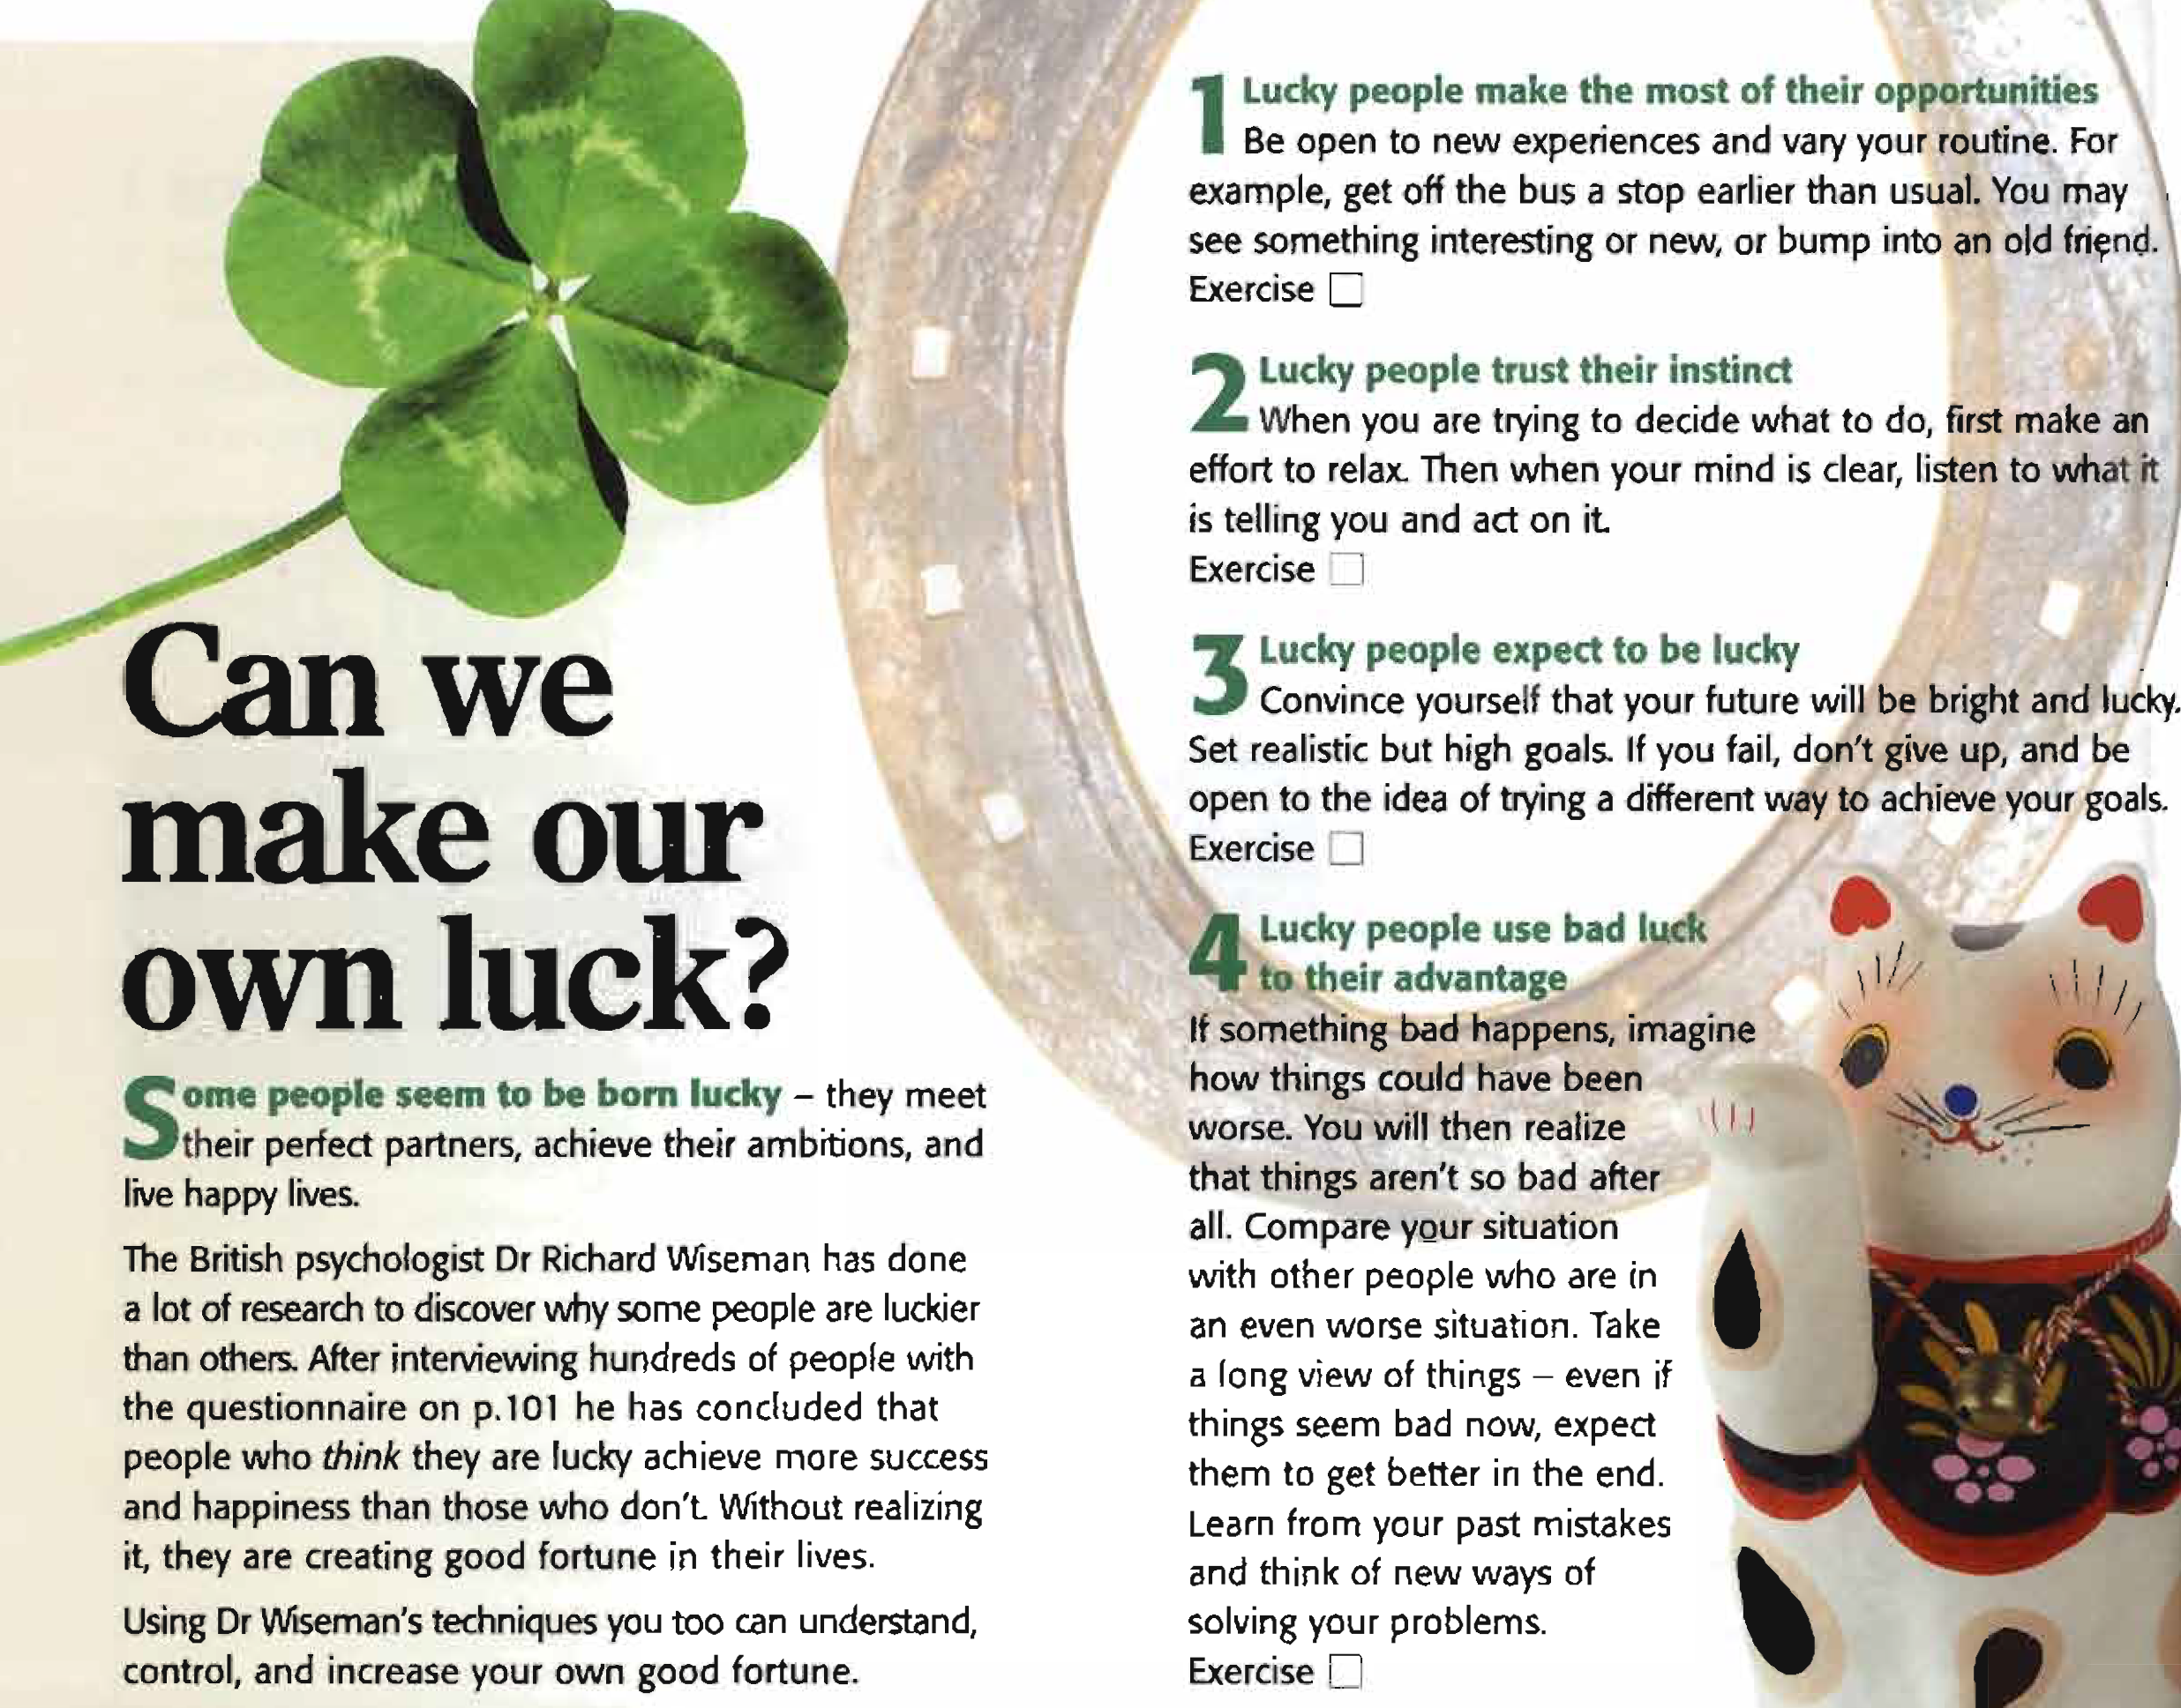
Read the article.
Match the exercises
A-D to paragraphs 1-4.

Slide 8
1 B / 2 D / 3 A / 4 C

Slide 9
Read just the article again (not the EXERCISES). Cover the text and from memory complete the expressions below with a verb or phrase.
1. ________ to be = give the impression of being
2. ________ their ambitions = make their ambitions come true
3. _______ your routine = change your routine, make it different
4. ________ _____an old friend = meet an old friend by chance
5. _________ an ________ to relax = try hard to relax
6. ________ yourself that your future will be bright = make yourself believe that your future will be bright
7. ______ that things aren’t so bad = understand that things aren't so bad
seem
achieve
vary
bump
into
make
effort
convince
realize

Slide 10
How words work
when you are trying to decide what to do, first make an effort to relax. Then when your mind is clear, listen to what it is telling you. We often use what as a relative pronoun. It means the thing (or things) which.
Complete the sentences with what or which.
1. Can you speak a bit louder? I can’t hear______ you’re saying.
2. A: What's this?
B: It's a machine _______ makes ice cream.
3. This is the song _______ won the MTV award.
4. Everybody was very surprised by _______ she said.
5. We went to the restaurant _______ Ann recommended.
6. I didn’t get _______ I wanted for my birthday!
what
which
which
what
which
what

Slide 11
Unit 6
Part A
3 VOCABULARY

Slide 12
Making adjectives and adverbs
Lucky people use bad luck to their advantage.
Look at the adjectives and adverbs that can be made from the noun luck in the chart below. Then complete the chart.
noun | + adjective | - adjective | + adverb | - adverb
Luck | Lucky | Unlucky | Luckily | Unluckily
Fortune | Fortunate | Unfortunate | Fortunately | Unfortunately
Comfort
Patience
Care
comfortable
uncomfortable
comfortably
uncomfortably
patient
impatient
patiently
impatiently
careful
careless
carefully
carelessly

Slide 13
Complete the sentences with the right form of the bold noun.
1. The beach was beautiful but ____________ it rained every day. FORTUNE
2. If the beds had been more ____________, we would have slept better. COMFORT
3. You would have got better marks if you hadn’t done the exam so ___________ . CARE
4. We were really ____________. We missed the flight by just five minutes. LUCK
5. Don’t be so ____________. The program will start in a minute. PATIENCE
6. I fell off my bicycle last week, but ____________ I wasn’t badly hurt. LUCK
7. There was a huge queue to pay, but we waited ____________ . PATIENCE
8. If you had been more ____________, you wouldn't have had an accident. CARE
9. It was freezing cold but ____________ we'd all brought jackets. FORTUNE
10. Are you sitting ____________ . Then I’ll begin the story. COMFORT
unfortunately
comfortable
carelessly
unlucky
impatient
luckily
patiently
careful
fortunately
comfortably

Slide 14
{{ Thank You }}

