Slide 1
New English File
Intermediate
Session 14

Slide 2
Unit 4
Part B
1 GRAMMAR

Slide 3
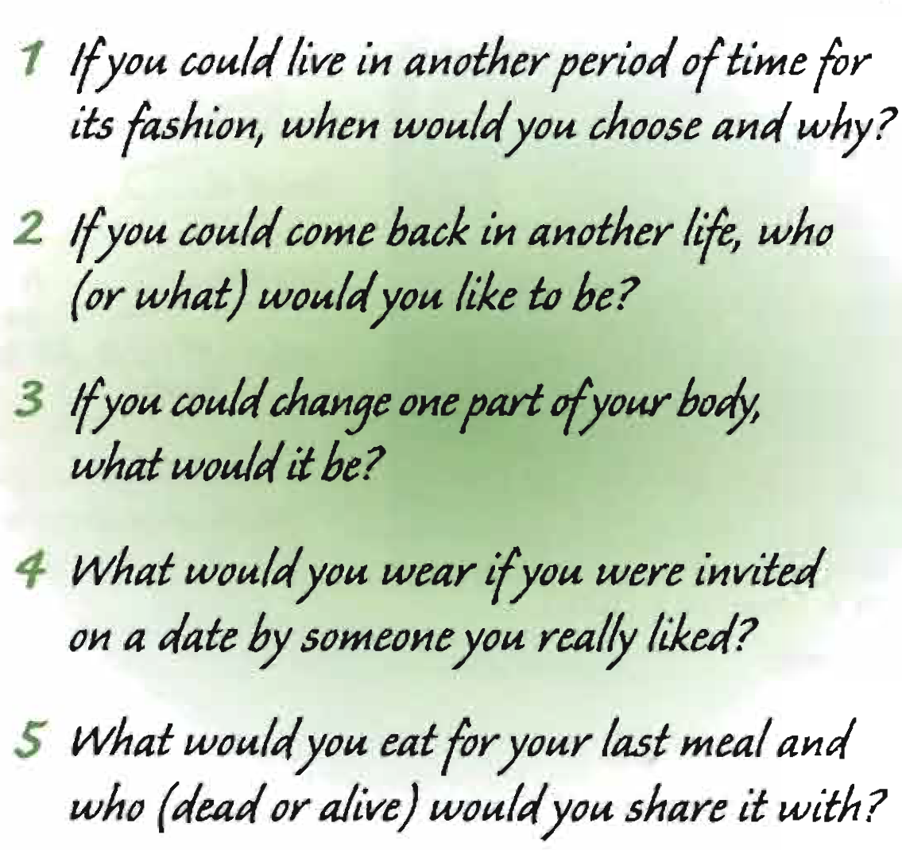
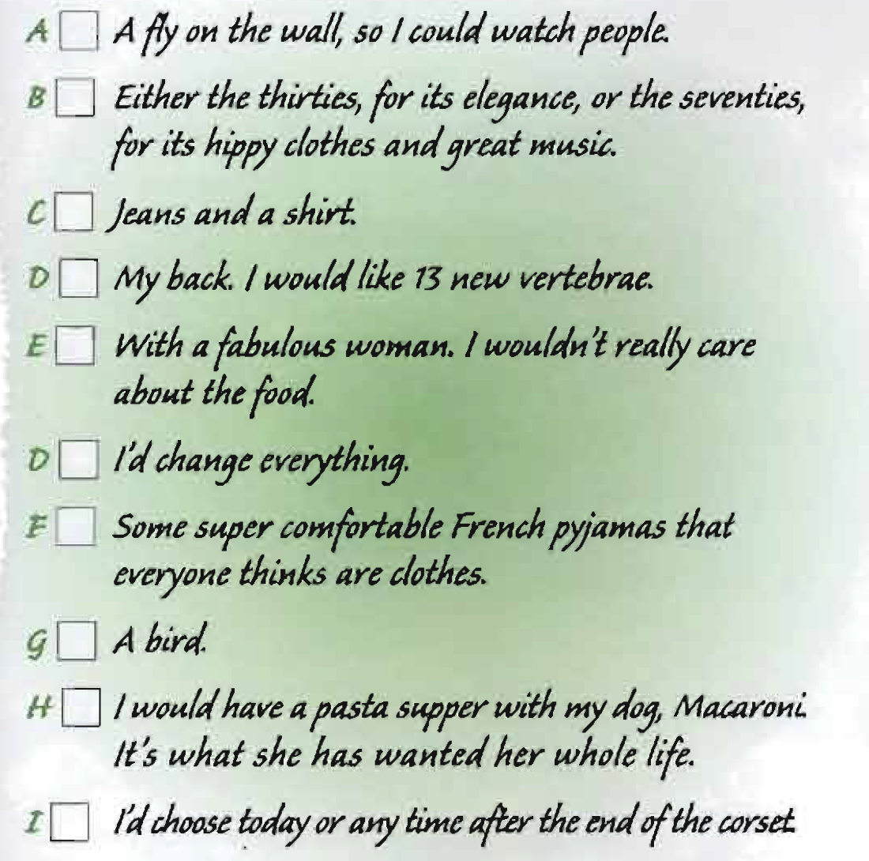
Read the questions, and match each question with its answers.
2
1
4
3
5
3
4
2
5
1

Slide 4
In questions 1-4 ,
1. what tense is the verb in the if clause?
2. What tense is the other verb?
3. How is question 5 different?
4. Do the questions refer to real or
imaginary situations?
1. The past tense.
2. The conditional form (would + infinitive).
3. There is no if-clause.
4. Imaginary situations.

Slide 5
Second Conditional
second conditional sentences: if + past simple, would / wouldn't + infinitive
-If I had more money, I’d buy a bigger house.
-If he spoke English, he could get a job in a hotel.
-I would get on better with my parents if I didn’t live with them.
-I wouldn’t do that job unless they paid me a really good salary.
-If I were you, I’d buy a new computer.
Use the second conditional to talk about a hypothetical / imaginary situation in the present or future and its consequence.
Compare:
I don't have much money, so I can’t buy a bigger house (real situation).
If I had more money, I’d buy a bigger house (hypothetical / imaginary situation).
Use second conditionals beginning If l were you, I’d... to give advice. Here you can’t use If I was you.

Slide 6
would/ wouldn’t + infinitive
-My ideal holiday would be a week in the Bahamas.
-I'd never buy a car as big as yours.
You can also use would / wouldn’t + infinitive (without an if clause) when you talk about imaginary situations.
The contraction of would is ‘d.
Remember the difference between first and second conditionals.
If I have time, I’ll help you. = a possible situation. I may have time.
If I Had time, I'd help you. = an imaginary / hypothetical situation. I don’t / won’t have time.

Slide 7
Write second conditional sentences.
Example: * If you / speak to your boss, I’m sure he / understand.
*If you spoke to your boss, I’m sure he would understand.
It / be better for me if we / meet tomorrow.
It would be better for me if we met tomorrow.
She / not treat him like that if she really / love him.
She wouldn’t treat him like that if she really loved him.
If I / can live anywhere in the world, /I live in New Zealand.
If I could live anywhere in the world, I’d / would live in New Zealand.
The kitchen / look bigger if we / paint it white.
The kitchen would look bigger if we painted it white.

Slide 8
I / not buy that house if I / be you.
I wouldn’t buy that house if I were you.
He / be more attractive if he / wear nicer clothes.
He’d / would be more attractive if he wore nicer clothes.
If we / not have children, we / travel more.
If we didn’t have children, we’d / would travel more.
What / you do in this situation if you / be me?
What would you do in this situation if you were me?

Slide 9
First or second conditional? Complete the sentences.
1. If you tell her anything, she ____ everybody in the office. (tell)
2. We’d have a dog if we ____ a garden. (have)
3. It’ll be quicker if we ____ a taxi to the airport. (get)
4. If you stopped smoking, you _____ better. (feel)
5. What would you do if you ___ your job? (lose)
6. If you buy the food, I ______ tonight. (cook)
7. I think he’d be happier if he ______ ___ alone. (not live)
8. I’ll be very surprised if Marina ____________ coming here. (not get lost)
9. Where will he live if he ______ the job in Moscow? (get)
10.If she didn’t have to look after her mother, she______ life more.(enjoy)
‘ll tell
had
get
‘d feel
lost
‘ll cook
didn’t live
doesn’t get lost
gets
‘d enjoy

Slide 10
Unit 4
Part B
2 VOCABULARY

Slide 11
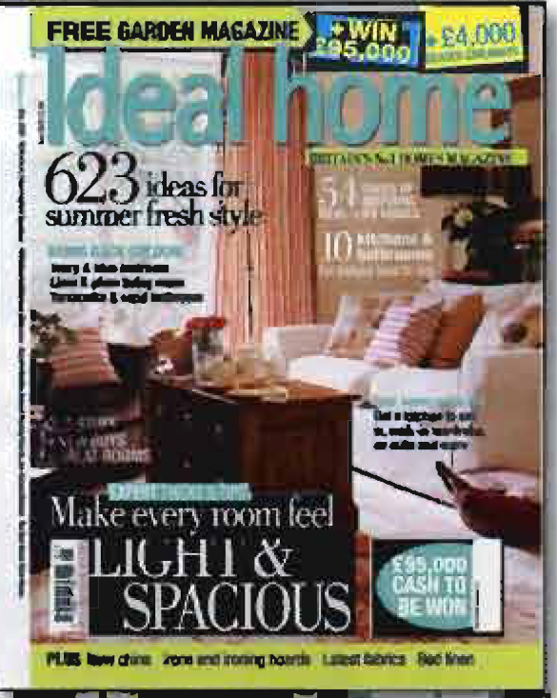
Houses
Look at the cover of Ideal Home magazine.
Which room is it? How many things in the room
can you name?
It’s a living room.
You can see:
curtains, a sofa, cushions, a carpet,
an armchair, a plant, a mirror.

Slide 12
1. Types of houses
Match the words and the pictures.
____block of flats (US apartment building)
____ cottage
____ detached house
____ terraced house
2
3
4
1

Slide 13
1. Where people live
Match the sentences.
1. I live in the country. ____
2. I live in the city centre.____
3. I live in the suburbs. ____
4. I live in a village. ____ 5. I live in a small town. ____
6. I live in in a residential area. ____
7. I live in on the second floor. ____
It has 20,000 inhabitants.
It’s very small, with only 800 inhabitants.
There are a lot of houses but no offices or big shops.
Its right in the middle of the city.
It’s the area outside the central part of town.
There are two floors below me.
There are fields and trees all around me.
G
D
E
B
A
C
F

Slide 14
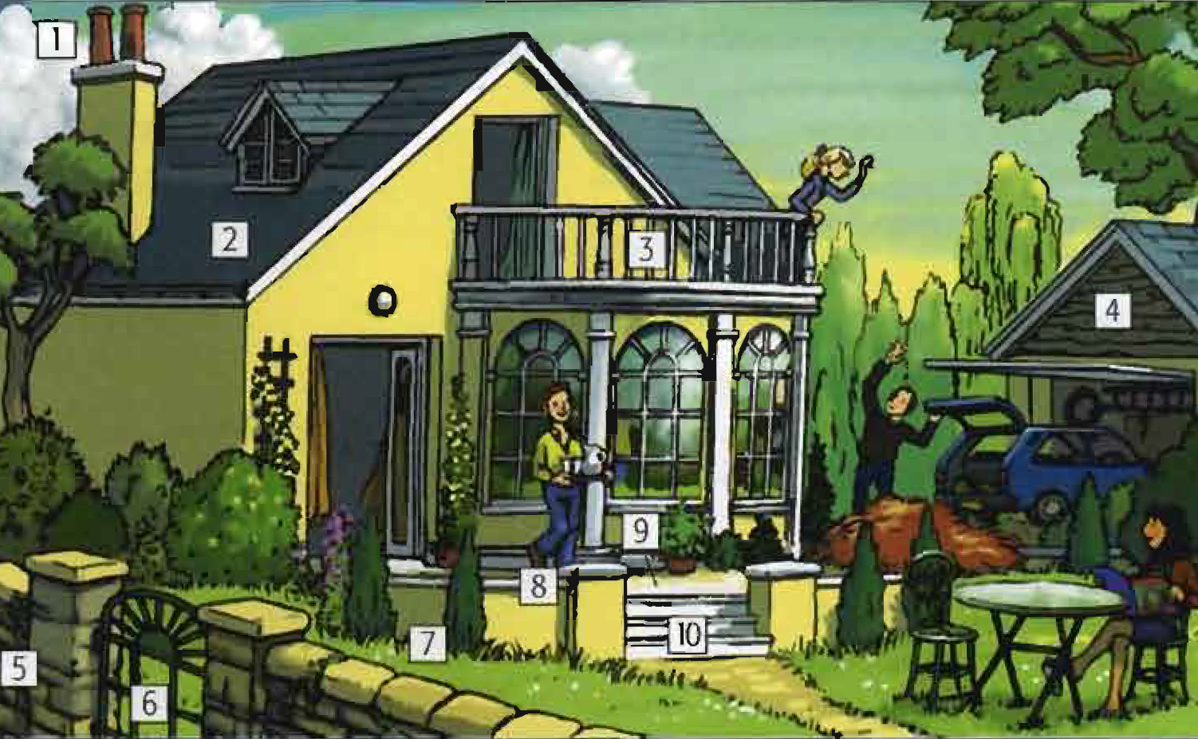
3. Parts of a house
Balcony ____
Chimney ____
Garage ____
Garden ____
Gate ____
Path ____
Roof ____
Steps ____
Terrace ____
Wall ____
3
1
4
7
6
10
2
8
9
5

Slide 15
3. Furniture
Put two words in each column.
washbasin sink shower bedside table dishwasher
coffee table armchair chest of drawers
Bathroom | Kitchen | Living room | Bedroom
washbasin
shower
Sink
dishwasher
Coffee table
armchair
Bedside table
Chest of drawers

Slide 16
Unit 4
Part B
3 READING

Slide 17
Houses you'll never forget // Casa Azul (The Blue House)
On the corner of Londres and Allende Street in Coyoacan, an old residential area of Mexico City, there is a house with bright blue walls, tall windows and green shutters, surrounded by trees. It is one of the most extraordinary places in Mexico, the home of the surrealist painter Frida Kahlo, who died in 1954, aged only 47.
The entrance is guarded by two giant statues nearly seven metres tall. As you walk past them, you enter a garden with tropical plants and fountains. When you go inside the house the first room is the spacious and airy Irving room. Here Frida and her husband, the painter Diego Rivera, entertained their famous friends, including the millionaire Nelson Rockefeller, the composer George Gershwin, and the political leader Leon Trotsky. Now the room is a gallery where some of Frida's paintings can be seen.
The first thing you notice when you go into the kitchen is the floor - painted bright yellow to stop insects from coming in. There is a long yellow table where Frida and Diego often had lunch parties, and a yellow dresser holding traditional green and brown Mexican dishes. Here, their guests often found themselves in the company of Frida's pets, Fulang Chang, a beloved monkey, or Bonito the parrot, who used to perform tricks at the table in return for butter!

Slide 18
Everywhere in the house you can feel the spirit of Frida and Diego, upstairs Frida's palette and brushes are still on the worktable in her studio, as if she had just put them down. In Diego's bedroom you can see his stetson hat and a huge pair of shoes - he had enormous feet. In another bedroom there is a cupboard with a glass door, which contains one of the colourful Mexican dresses which Frida loved wearing.
Above the cupboard, in Spanish, are painted these words: 'Frida Kahlo was born here on July 7 1910'. In fact, she was born three years earlier (July 6th 1907) but she changed her birth date to the year of the Mexican Revolution. On the walls of the patio is another inscription 'Frida and Diego lived in this house from 1929-1954', Again, this is not entirely true. She and her husband lived in separate houses for five years during that period, and they divorced in 1939, though they remarried a year later. The house, like Frida's life, is full of contradictions.

Slide 19
Read the article about Casa Azul. Which part of the house are these things connected to? Why are they mentioned? two giant statues Leon Trotsky a yellow floor a monkey and a parrot
a pair of shoes a cupboard with a glass door July 7 1910 1929-1954
Two giant statues - the entrance: they guard it, and are nearly 7 metres tall.
Leon Trotsky - the living room. He was a political leader who was a friend of Frida Kahlo’s and who visited the house.
A yellow floor - the kitchen has a yellow floor to stop insects from coming in.
A monkey and a parrot - the kitchen, where they used to have their meals. The monkey and parrot were Frida’s pets. The parrot used to do tricks at the table in return for butter.
A pair of shoes - Diego’s bedroom. They can be seen there today. They are enormous because Diego had very big feet.
A cupboard with a glass door - upstairs in a bedroom. It contains a colourful Mexican dress which Frida loved wearing.
July 7 1910 - this date is written above the cupboard with the glass door. It says that Frida was born on this day but she wasn’t. She was born three years earlier.
1929-1954 - These dates are written on the walls of the patio. It says that Frida and Diego lived in the house for those years. In fact they lived separately for some of that time.

Slide 20
Match the highlighted words with their meaning.
1. ______________a piece of furniture with cupboards at the bottom and shelves above, to hold cups and plates, etc.
2. ______________ material which you can see through
3. ______________ the door, gate, or opening where you go into a place
4. ______________ a room where paintings are hung
5. ______________ the floor above where you are
6. ______________ with a lot of fresh air inside
7. ______________ wooden or metal covers which are fixed outside windows
8. ______________ an area, usually behind a house, where people can sit and eat outside
Dresser
Glass
Entrance
Gallery
Upstairs
Airy
Shutters
Patio

Slide 21
{{ Thank You }}

