Slide 1
New English File
Intermediate
Session 12

Slide 2
Unit 3
Writing
An informal letter

Slide 3
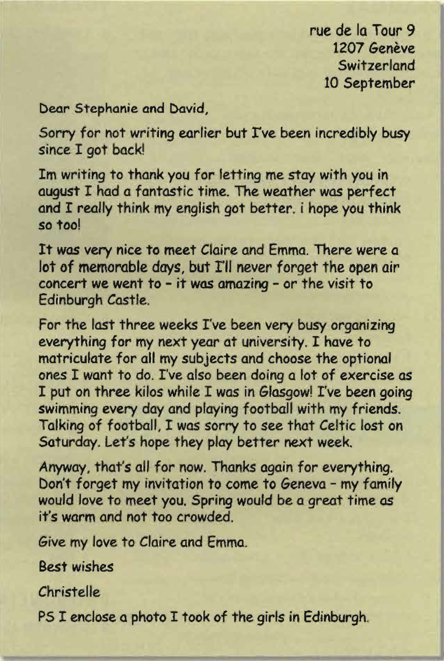
Read the letter, then order the following 1-7.
She suggests the best time to come to Geneva. ___
She thanks them for having her to stay. ___
She talks about what she's been doing recently. ___
She apologizes for not writing before. ___
She mentions two really good experiences in Scotland. ___
She thanks them again and invites them to stay. ___
She talks in general about the nice things that
happened in Scotland. ___
7
2
5
1
4
6
3

Slide 4
Find and correct five punctuation mistakes in the second paragraph.
Im writing to thank you for letting me stay with you in august I had a fantastic time. The weather was perfect and I really think my engLish got better, i hope you think so too!
I’m writing to thank you for letting me stay with you in August. I had a fantastic time. The weather was perfect and I really think my EngLish got better, I hope you think so too!

Slide 5
Useful language: informal letters / emails
Beginnings
Dear + name (email: Dear or Hi)
Sorry for not writing earlier but...
Thank you / Thanks (so much) for (your letter, having me to stay, etc.).
It was great to hear from you...
Endings
That’s all for now.
Hope to hear from you soon. / Looking forward to hearing from you.
(Give my) regards / love to...
Best wishes / Love (from)
PS I enclose a photo of the three of us (email: I attach...)

Slide 6
Unit 3
Review
What do you remember?

Slide 7
Grammar
Complete the second sentence with two words so that it means the same as the first. Contracted forms: e.g. isn't, count as one word.
I really think it's important for you to learn to drive.
You really ___________ to drive.
Why don’t you join a tennis club? It would be good for you.
I think you ___________ a tennis club.
I’m sure she’s not American. She hasn’t got an American accent.
She ___________ American she hasn’t got an American accent.
I can’t go out tonight.
I won’t _________ to go out tonight.
It’s prohibited to take photos there.
You _________________ photos there.
must learn
should join
can’t be
be able
mustn’t / can’t take

Slide 8
I’m not sure if she’ll like her present.
She __________ like her present.
Wearing a uniform is not obligatory.
You __________ to wear a uniform.
The lights are on so I’m sure he’s at home.
The lights are on so he __________ at home.
I think perhaps this is their house.
This __________ their house.
Paying in advance is obligatory at this school.
You __________ pay in advance at this school.
Drinking a lot of coffee isn't a good idea.
You _____________ a lot of coffee.
might not
don’t have
must be
might be
have to
shouldn’t drink

Slide 9
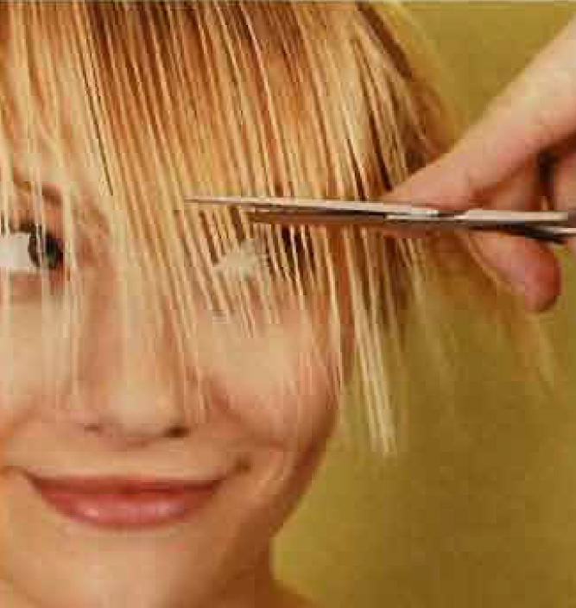
Vocabulary
Complete the description.
My cousin Ann is very attractive. She’s
in her ___twenties - 24 or 25 I think.
She's blonde, with shoulder-______hair.
It's completely _______ , not curly at all.
Her ________is very long and gets in her
eyes. She's very short-sighted but she
______contact lenses.
mid
length
straight
fringe
wears

Slide 10
Complete with an adjective from the bold verb.
1. Are you _____________ in sport? interest
2. I was very _____________ when I failed the exam. depress
3. This book is really _____________ . I can’t finish it. bore
4. I completely forgot his name. It was so _____________! embarrass
5. I felt very _____________ because I just couldn’t do it. frustrate
interested
depressed
boring
embarrassing
frustrated

Slide 11
Complete with one word.
1. Please switch _______ your mobile. You can’t use it here.
2. I’m afraid John’s out. Can you call _______ later?
3. I can’t believe it! He hung _______ in the middle of our conversation!
4. She looks _______ her mother. They both have big eyes.
5. He’s _______ his late forties.
off
back
up
like
in

Slide 12
Reading The best day of my life
One of he best days of my life was when my agent phoned to say that my first novel, The Ice House, had been accepted by a publisher- I'd finished the book 18 months earlier, and I didn't think it was ever going to be published. It was one morning in the autumn of 1990 when the phone call came I was 39, and a friend of mine turned up, sat down at my kitchen table and burst into tears because she was having problems with her marriage. I was doing my best to try to console her when the phone rang. So there I was, listening to the best news of my life, while my friend was crying over the worst news of her life. My agent said, 'Aren't you pleased? why aren't you more excited?’ I said, I am but I’ll tell you later. I put the phone down and tried to be sympathetic to my friend. But at 1 o'clock I couldn't stand it any longer so I said, 'Stay there I have to go out for ten minutes'. I came back with a bottle of champagne. ‘You and I are going to drink some champagne,’ I said, and told her my good news. She was a much happier lady when she left! I can’t I remember how many publishers had turned down my book, because my agent didn’t tell me. I don't know how many copies it's sold now , a couple of million I should think because it's published in 36 countries. But I have absolutely no sympathy for those publishers who rejected my book. I was deeply hurt at the time, but now I'm laughing!

Slide 13
Can you guess the meaning of the highlighted words?
She burst into tears because she was having problems.
I tried to be sympathetic with my friend.
I couldn’t stand the noise any longer.
Many publishers turned down my book. It wasn’t up to the level.
I was deeply hurt at that time, but now I am laughing.
Suddenly start crying
Understanding other people’s feelings
Couldn’t tolerate / stand
Refused/ rejected
Very unhappy

Slide 14
Choose a, b, or c.
1. In 1990 Minette Walters was ____ about the chances of her first novel being published.
a quite optimistic b quite pessimistic c quite worried
2. When her agent first phoned, Minette felt that she ____celebrate the news.
a shouldn’t b had to c could
3. Her agent couldn’t understand ____.
a why she was crying b what she was saying c her reaction
4. In the end Minette's good news made her friend ____.
a feel better b feel worse c leave early
5. Now that she is very successful, she ____ the publishers who rejected her.
a feels positive towards b feels negative towards c understands

Slide 15
{{ Thank You }}

