Slide 1
New English File
Intermediate
Session 11

Slide 2
Unit 3
Part C
1 READING

Slide 3
If at first you don’t succeed,…
Read the article about people who have tried (but failed) to learn something. Complete the text with these phrases.
A. I've never been able to say B. I was able to learn
C. you'll never be able to speak D. I just wasn't able to do it
E. I hate not being able to communicate F. I would suddenly be able to do it
G. all my friends are able to do
I started having driving lessons when I was 17. Although I’m normally a quick learner, 1 ____ After 18 months I failed my first test – I was really disappointed. Since then I've taken the test again three times, but I've always failed - usually on reversing or parking. The problem is I get so nervous during the tests that I can't drive properly. It’s so embarrassing to admit that I can’t learn to do something that 2 ____!
Amanda, Brighton
D
G

Slide 4
A. I've never been able to say B. I was able to learn
C. you'll never be able to speak E. I hate not being able to communicate
F. I would suddenly be able to do it
I’ve always wanted to be able to dance salsa, and when I was working in Ecuador there were free classes, so I joined. But the art of salsa is to keep your arms still and move your hips, and I just couldn’t do it. When I hear music my arms start moving but my hips don’t. After about ten hours of classes 3 ____ the steps, but I was
dancing like a robot! I didn't give up, but soon everyone in the class was dancing and I was just slowly moving from side to side and counting out loud 'one, two, three, four>.I was sure that one day 4 ____ but that never happened. I can still remember the first two steps, though, and I still try to dance when I hear a salsa tune, as long as nobody is watching.
Seon, Oxford
B
F

Slide 5
A. I've never been able to say
C. you'll never be able to speak
E. I hate not being able to communicate
I’ve started learning English at least ten times. I've been to classes, I've had a private teacher, I've used a self-study course, but 5 ____ anything in English. I even had an English girlfriend once but she learned Spanish before I managed to improve my English, so we always spoke in Spanish. I travel a lot in my job and 6 ____ it's so frustrating. I’m thirty-two now and I think if you don't learn a language when you’re a child, or go and live in the country, 7 ____ it well.
Guillermo, Madrid*
* translated from Spanish
A
E
C

Slide 6
Look at phrases A-G. What tense or form of be able to are they?
A. I've never been able to say
B. I was able to learn
C. you'll never be able to speak
D. I just wasn't able to do it
E. I hate not being able to communicate
F. I would suddenly be able to do it
G. all my friends are able to do
Present Perfect
Past Simple
Future with will
Past Simple
Gerund
Conditional
Present Simple

Slide 7
Unit 3
Part C
2 GRAMMAR

Slide 8
(Can, Could, Be able to for ability or possibility)
Can / Could
I can speak Spanish very well.
She could play the violin when she was three.
She can’t come tonight. She's ill.
They couldn’t wait because they were in a hurry.
Could you open that door, please?
Can is a modal verb. It only has a present, past, and conditional form (but can also be used with a future meaning).
For other tenses and forms use be able to.

Slide 9
(Can, Could, Be able to for ability or possibility)
Be able to + infinitive
I am able to accept your invitation.
They weren't able to come.
I’ll be able to practise my English in London.
She has been able to speak French since she was a child.
I’d like to be able to ski.
I'd love being able to sleep late at weekends.
You can use be able to in the present, past, future, present perfect, and as a gerund or infinitive.
be able to in the present and past is more formal than can / could.

Slide 10
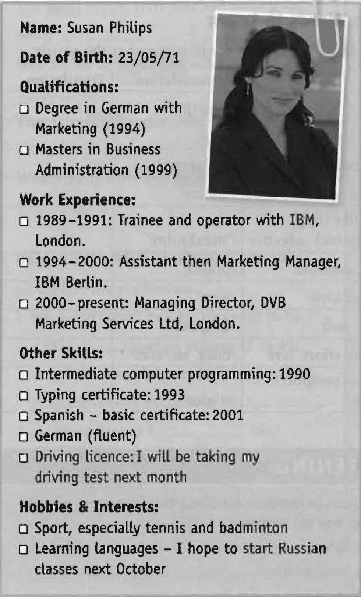
Complete the sentences with the correct form of
can, could, or be able to.
-Susan ______ play badminton.
-She _______ type when she started working
for IBM Berlin.
-She ______speak Italian.
-She ____________ write computer programs
since at least 1990.
-She'd like ___________ speak Russian.
-She ______ speak Spanish when she was
with IBM London.
-She ______________ drive a car very soon.
can
could
can’t
has been able to
to be able to
couldn’t
will be able to

Slide 11
How words work
Look at the two uses of so. Match them with their uses.
1. It’s so frustrating!
2. The classes were free, so I joined.
____to emphasize an adjective or adverb
____to connect a cause and a result
Look at the sentences below. Is so use 1 or use 2?
-I love Paris - it's so beautiful. ____
-The bus didn’t come so I walked home. ____
-Why does he talk so much? ____
-I was so tired that I went to bed at 9.00. ____
-I was tired so I went to bed. ____
1
2
1
2
1
1
2

Slide 12
Match the sentence halves.
I was very late for work ____ I was so tired ____ I'm frightened of flying ____ I was so disappointed with the restaurant ____ I didn't want to speak to anyone ____ I was so worried about the exam ____ | so I always travel by car. (that) I studied until 3.00 a.m. (that) I went straight to bed. so I took a taxi. (that) I never went there again. so I turned off my mobile.
D
C
A
E
F
B

Slide 13
Unit 3
Part C
3 VOCABULARY

Slide 14
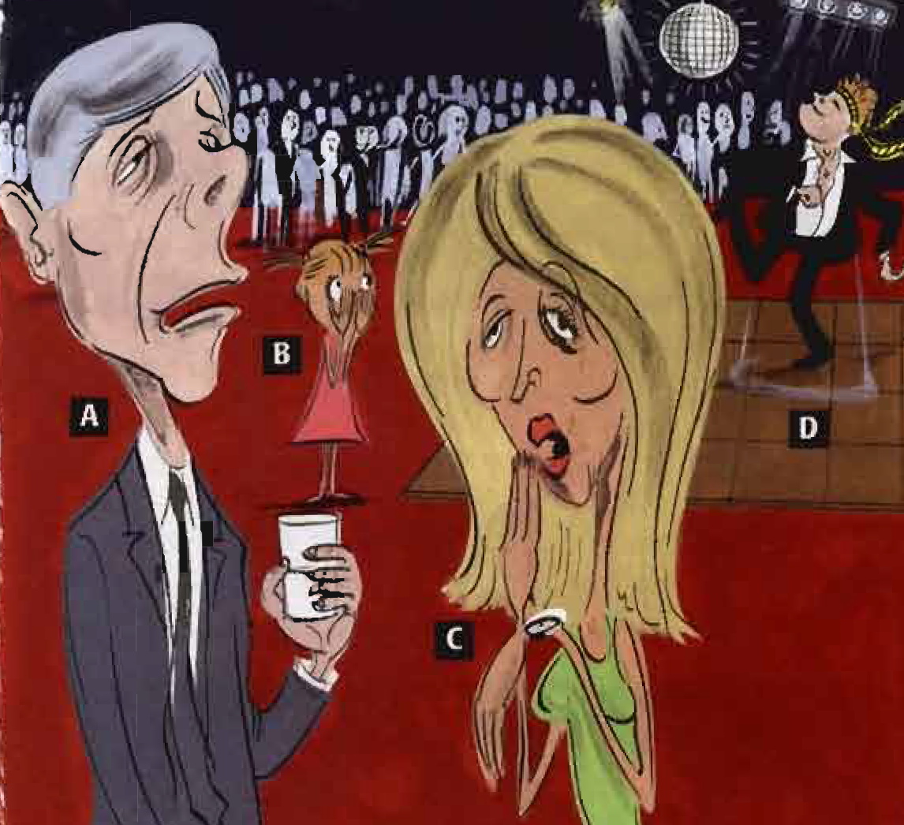
Look at the picture.
1. Which person is bored? Which person is boring?
2. Which person is embarrassed? Which person is
embarrassing?
Underline the correct adjective in these sentences.
1. I failed my first test - I was really disappointed / disappointing.
2. It’s so embarrassed / embarrassing to admit I can’t do something that all my friends are able to do.
3. I hate not being able to communicate - its so frustrated / frustrating.

Slide 15
Complete the adjectives with -ed or -ing.
1. What do you think is the most excit _____sport to watch?
2. What music do you listen to if you feel depress _____ ?
3. What was the last interest _____ TV programme you watched?
4. Have you ever been disappoint _____ by a birthday present?
5. Which do you find more tir _____, travelling by car or by public transport?
6. Are you often bor _____ at work or school?
7. What’s the most embarrass_____ thing that's ever happened to you?
8. Are you frighten _____ of any insects?
9. Do you feel very tir _____ in the morning?
10. What’s the most bor _____ film you’ve seen recently?
ing
ed
ing
ed
ing
ed
ing
ed
ed
ing

Slide 16
Underline the correct answer.
My grandmother gets terribly tired / tiring if she does too much.
It's very worried / worrying as we haven't heard from him since he went to South Africa.
Apparently their holiday was very bored / boring.
You must be excited / exciting about your new job.
Tell me more about your time in New York - it’s very interested / interesting.
The news today is so depressed / depressing.
I felt so embarrassed / embarrassing when I couldn't remember her name.

Slide 17
{{ Thank You }}

