Slide 1
New English File
Intermediate
Session 6

Slide 2
Unit 2
Part B
1 GRAMMAR

Slide 3
Present Perfect Continuous with for / since
Read the following sentences, then answer the questions.
How long have you been living here?
I have been drawing and painting since I was little.
What have you been doing here since you arrived?
I have been having classes with her since October.
I have been teaching belly dancing for about six years.
1. Are the verbs action or non-action verbs?
2. Do they refer to single actions or continuous / repeated actions?
3. Do they refer to a completed action or one which is still happening?
Action verbs
Continuous / repeated actions
One which is still happening

Slide 4
Present perfect continuous for unfinished actions
How long have you been learning English?
He's been working here since April.
They’ve been going out together for three years.
have / has been + verb + -ing
Use the present perfect continuous with for and since with action verbs (e.g. learn, go, etc.).
With non-action verbs (e.g. know, be, etc.) use the present perfect simple NOT the present perfect continuous with for and since.
I’ve known her for ages. Not I’ve been knowing her for ages.
With live and work you can use the present perfect simple or continuous with for and since
I've been living here for six months.
I've lived here for six months.

Slide 5
Use the present perfect continuous for actions which have been going on very recently.
A Your eyes are red. Have you been crying?
B No, I’ve been cutting onions.

Slide 6
Make sentences with the present perfect continuous (and for/ since if necessary).
1. she / work / here / 2003.
She has been working here since 2003.
2. how / long / they / go out / together?
How long have they been going out together?
3. he / not / feel / very well/ recently.
He hasn’t been feeling well recently.
4. you/ wait / a long time?
Have you been waiting for a long time?

Slide 7
Make sentences with the present perfect continuous (and for/ since if necessary).
5. I / study / English / two years.
I have been studying English for two years.
6. you / read / that book / months!
You have been reading that book for months!
7. we / not / spend / much / time / together.
We haven’t been spending much time together.
8. I / rent / this flat / three years.
I have been renting this flat for three years.

Slide 8
Make sentences with the present perfect continuous (and for/ since if necessary).
9. the lift / not / work / 10 o’clock.
The lift hasn’t been working since 10 o’clock.
10. she / work / here / a long time?
Has she been working here for a long time?

Slide 9
Complete with a verb from the list in the present perfect continuous.
bark cry eat shop not sleep watch
1. A: Your sister's lost a lot of weight!
B: Yes. She _________________a lot less recently.
2. A: Your eyes are red. _________ you __________ ?
B: Yes. I ___________________ a sad film.
3. A: It's very late. Why aren’t you in bed?
B: I can’t sleep. That dog _______________ for the last two hours.
4. A: You look tired.
B: I know I _________________ well recently.
5. A: Wow! You’ve bought a lot of things.
B: Yes. We ______________all day.
has been eating
Have
been crying
have been watching
has been barking
haven’t been sleeping
has been shopping

Slide 10
Unit 2
Part B
2 READING

Slide 11
It was just a holiday, but it changed my life
Read the texts and answer the questions about each woman.
What is she doing now?
What was she doing before?
What made her change her Life?
How does she feel now?

Slide 12
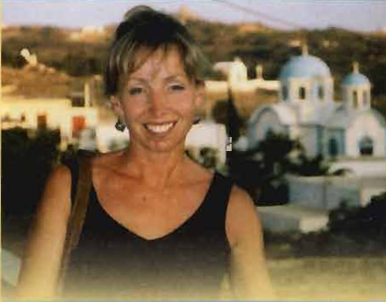
Victoria Smith six years ago, was working as a manager at Next, a British chain store. Then she went on holiday to Borneo...
“It was a working holiday,” said Victoria, “where you could study orangutans in the wild -I have always been interested in apes, so I thought it would be fun.” the holiday was wonderful, and when Victoria came home she found it very difficult to return to her old life. “Suddenly the problems in the store just seemed so trivial”. Although everybody told her she was mad, she decided to go back to university and study biology. Four years later she became a chimpanzee keeper.
For the last two years Victoria has been working at Monkey World, a center in south-west England which looks after apes which have been ill-treated. Many have been rescued from laboratories and circuses all over the world. She works long hours, and the pay isn’t very good, but she loves it. “Apes are like a big family, each with their own personality.” I’m really happy now. Since I started working here I feel that I’ve been doing something important, not just wasting my life.”
Suddenly I knew there was a
different life waiting for me

Slide 13
Sally Gook wakes up every morning to a deep blue sky and blazing sun. For the last two years she has been living on the tiny Greek island of Lipsi, which is only 16 kilometers in size and has a population of just 650.
But until a few years ago she lived in London. “ I was working for American Express and I had a good social life and earned a lot of money. But I had to get up every morning, often in horrible weather, and get a train and the tube to work.”
Then on e day she and a friend decided they needed a relaxing holiday and they came to Lipsi. “I loved it - the people, the mountains, the sun and the delicious food. Suddenly I knew there was a different life waiting for me here.” a few months later she applied for a job at the travel company which had organized her holiday.
Since then she has been living on Lipsi and working as a tourist guide.
Her boy friend, who is Greek, is a farmer. Sally said, “I’ve only been
back to London once, and I can’t imagine ever living there again.”
“I feel I’ve been doing something
important.”

Slide 14
Let’s answer the questions about Victoria and Sally
Sally What is she doing now? What was she doing before? What made her change her Life? How does she feel now? | Victoria What is she doing now? What was she doing before? What made her change her Life? How does she feel now?
She is working at monkey world.
She’s living on the Greek island of Lipsi
She was working as a manager at Next, a chain store.
She was living in London, working for American Express. She had a good salary but she did not enjoy her life
She went on working holiday to Borneo She worked with apes and enjoyed it. When she came back, she found it difficult to return to her old life. She decided to go back to university to study biology.
She went on holiday to the island of Lipsi. She loved it there. She applied for a job there.
She’s very happy there. She can’t imagine living in London again.
She’s really happy now. She feels that she’s doing something important, not wasting her life.

Slide 15
Match the highlighted words with their meaning.
Text 1
of little importance
crazy
a person who looks after animals in a zoo
animals like large monkeys
Not looked after well
trivial
mad
keeper
apes
ill-treated

Slide 16
Text 2
the London underground
very tasty
asked for (in writing)
burning brightly
very small
the tube
delicious
applied for
blazing
tiny

Slide 17
Unit 2
Part B
3 VOCABULARY

Slide 18
Write synonyms for the strong adjectives.
Tiny = very
Delicious = very
Furious = very
Terrified = very
Exhausted = very
Boiling = very
Starving = very
Enormous = very
Freezing = very
Filthy = very
Great = very
Awful = very
small
tasty
angry
afraid
tired
hot
hungry
big
cold
dirty
good
bad

Slide 19
Complete the responses with a strong adjective.
1. Are you hungry? Yes, I’m __________
2. Was your mother angry? Yes, she was __________
3. Is her flat small? Yes, it’s __________
4. Are you tired? Yes, I’m __________
5. Is the floor dirty? Yes, it’s __________
6. Are you afraid of spiders? Yes, I’m __________
starving
furious
tiny
exhausted
filthy
terrified

Slide 20
Unit 2
Part B
4 GRAMMAR

Slide 21
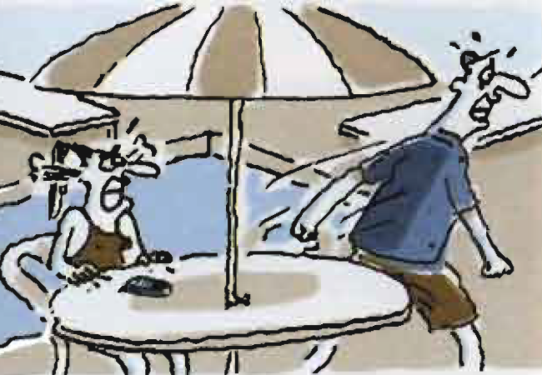
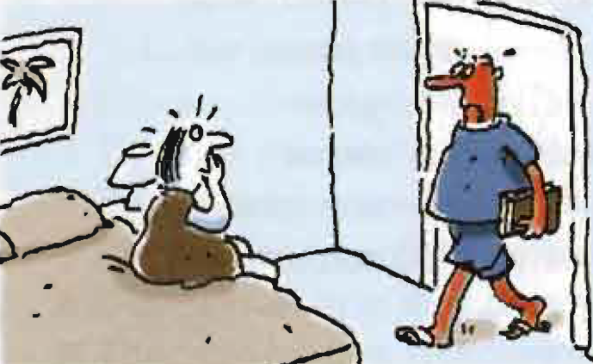
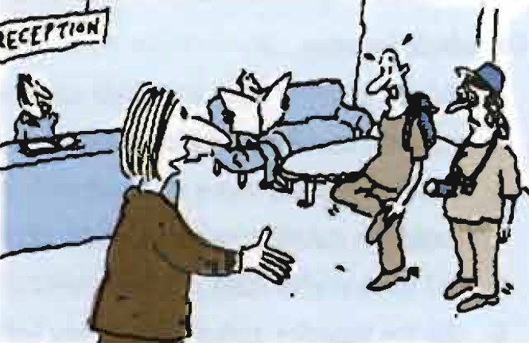
present perfect continuous (for recent continuous actions)
Look at the pictures, and read the sentences.
1. Sharon and Kenny have been arguing.
2. The man has been reading by the pool (without any suncream on)
3. The man and the woman have been sightseeing and walking all the afternoon.

Slide 22
Present perfect continuous for recent continuous actions
A Your eyes are red. Have you been crying?
B No, I’ve been cutting onions.
Use the present perfect continuous for actions which have been going on very recently.

Slide 23
You look exhausted. What have you been doing?
You look filthy. What have you been doing?
You look very stressed. What have you been doing?
You look very red. What have you been doing?
I’ve been cleaning the garage.
I’ve been working in the garden.
I’ve been thinking about the exam.
I’ve been lying in the sun near the pool with no suncream on.

Slide 24
{{ Thank You }}

