Slide 1
New English File
Intermediate
Session 2

Slide 2
Unit 1
Part B
1 GRAMMAR
Past tenses: Simple, Continuous, Perfect

Slide 3
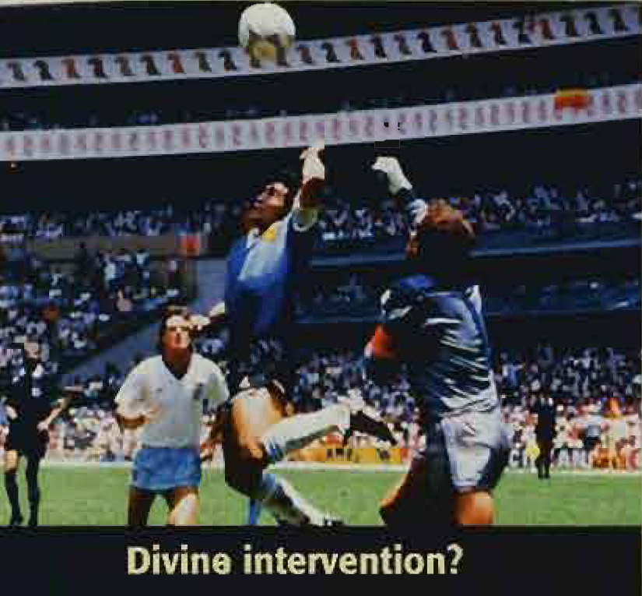
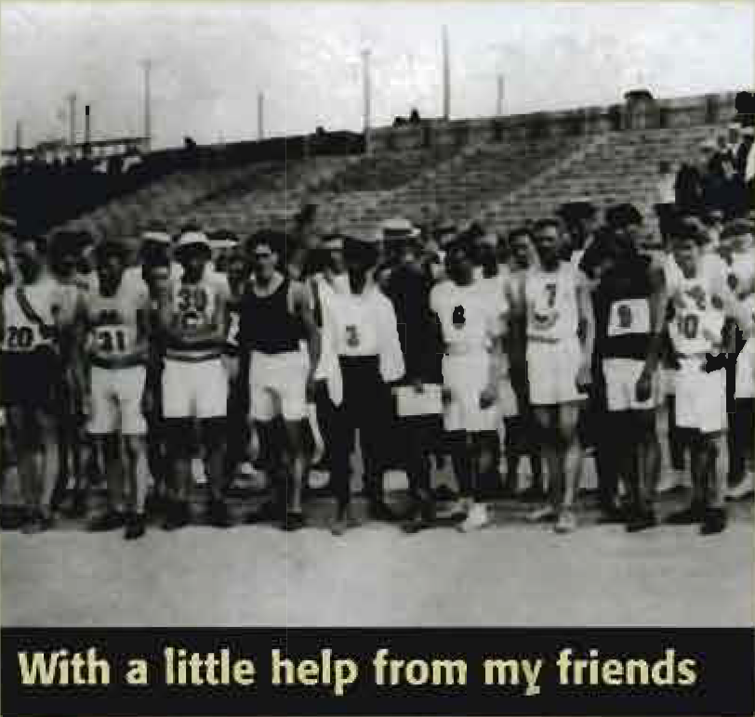
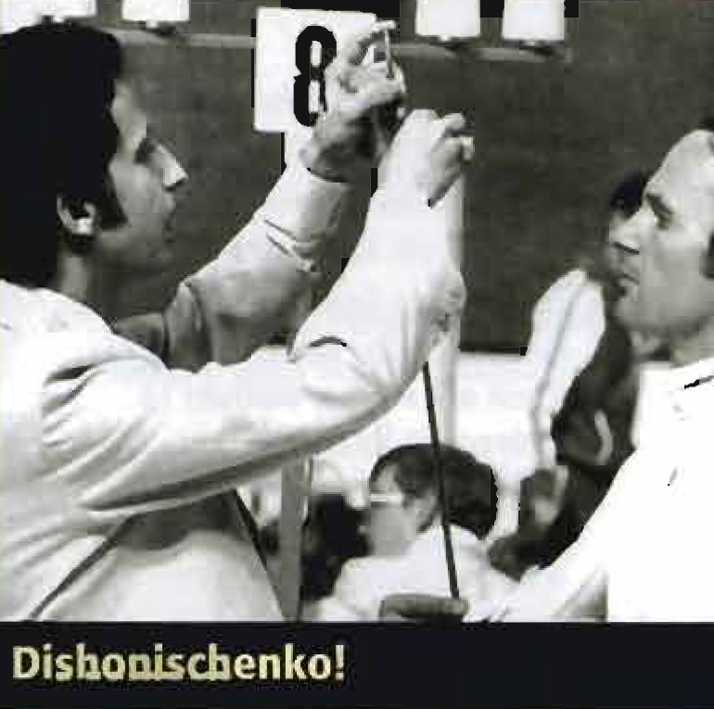
Read the three texts below.
Famous cheating moments in sport
1 FOOTBAL Argentina were playing England in the quarter finals of the 1986 World Cup in Mexico. In the 52nd minute the Argentinian captain, Diego Maradona, scored a goal. The English players protested but the referee gave the goal. However, TV cameras showed that Maradona had scored the goal with his hand! Maradona said the next day, ‘It was partly the hand of Maradona, and partly the hand of God.’ Later in the game Maradona scored another goal and Argentina won 2-1. They went on to win the World Cup. | 2 ATHLETICS Fred Lorz, from New York, won the marathon at the St louis Olympic Games in 1904. He finished the race in three hours 13 minutes. After the race Fred was waiting to get his medal and the spectators were cheering him loudly. Alice Roosevelt, the daughter of the US President, was in the crowd, and some journalists took a photo of Fred with her. But then suddenly somebody started shouting 'cheat' and soon everybody was shouting the same thing. It was true. Fred had travelled 18 of the 42 kilometers in a friend’s car! Fred didn’t win the gold medal and he was banned from athletics. | 3 FENCING Boris Onischinko, an army officer from the Soviet Union, was competing against Jim Fox from Britain in the 1976 Montreal Olympics. Boris was winning and the electronic scoreboard was showing 'hit' after 'hit' for him. Jim Fox protested to the referee. Fox said that Boris was scoring points without hitting him. Olympic officials examined Boris’s sword and they made a shocking discovery. Boris had changed the electronic part of his sword. He could turn on the 'hit' light on the scoreboard even when he hadn't hit Fox. Boris went home, in disgrace, the next day. The British newspapers called him ‘Dishonischenko’,

Slide 4
B. Look at the highlighted verbs in Text 1. What three tenses are they? Underline an example of each tense in the other two texts.
were playing
was competing & was waiting
protested
finished & started
had played
had traveled & hadn’t hit
Past Continuous
Past Simple
Past Perfect

Slide 5
Past Tenses
Past simple: worked, stopped, went, had, etc.
They got married last week.
What time did you wake up this morning?
I didn't have time to do my homework.
Use the past simple for finished past actions.

Slide 6
Past Tenses
Past continuous: was / were + verb + -ing
A What were you doing at six o'clock last night?
B I was watching TV. It was a cold night and it was raining.
Use the past simple continuous to describe an action in progress at a specific time in the past.

Slide 7
Past Tenses
Past perfect: had + past participle
When they turned on the TV, the match had finished.
I felt nervous because I hadn't flown before.
Use the past perfect when you are talking about the past and you want to talk about an earlier past action.

Slide 8
Using Narrative Tenses Together
When John arrived, they had dinner.
(first John arrived, then they had dinner.)
When John arrived, they were having dinner.
(When John arrived they were in the middle of dinner.)
When John arrived, they had had dinner.
(They had dinner before John arrived.)

Slide 9
Combine the two sentences. Use the verb in bold in the past continuous or past perfect.
e.g. Sarah had a siesta from 3.00 to 5.00. Peter picked up the tickets at 4.00.
Peter picked up the tickets when Sarah was having a siesta.
1. They watched TV from 7.00 until 9.00. I arrived at 7.30.
When I arrived, they TV.
2. He left the office at 7.00. She phoned him at 8.00.
When she phoned him, he the office.
3. I studied for the exam the night before. The exam didn’t go well.
The exam didn’t go well although I the night before.
4. He cycled to work this morning. In the middle of his journey, he had an accident.
When he to work this morning, he had an accident.
5. He only had five lessons. He passed his driving test.
When he passed his driving test, he five lessons.
were watching
had left
had studied
was cycling
had only had

Slide 10
Complete with the past simple, past continuous, or past perfect.
e.g. We didn’t realize that we had been there before. (not realize, be)
1. A: How ____? (the accident / happen)
B: He ____ back from Manchester when he ____ a tree. (drive, hit)
2. I ____ cooking the meal when they ____ me to say they couldn’t come. (already /start, call)
3. When I got home 1 was really tired, so I ____ a shower and ____ to bed. (have, go)
4. I arrived too late. The concert ____ and my friends ____ home. (finish, go)
5. The driver ____ control of his car because he ____ on his mobile. (lose, talk)

Slide 11
Now check your answers.
e.g. We didn’t realize that we had been there before. (not realize, be)
1. A: How did the accident happen? (the accident / happen)
B: He was driving back from Manchester when he hit a tree. (drive, hit)
2. I had already started cooking the meal when they called me to say they couldn’t come. (already /start, call)
3. When I got home I was really tired, so I had a shower and went to bed. (have, go)
4. I arrived too late. The concert had finished and my friends had gone home. (finish, go)
5. The driver lost control of his car because he was talking on his mobile. (lose, talk)

Slide 12
Unit 1
Part B
2 VOCABULARY

Slide 13
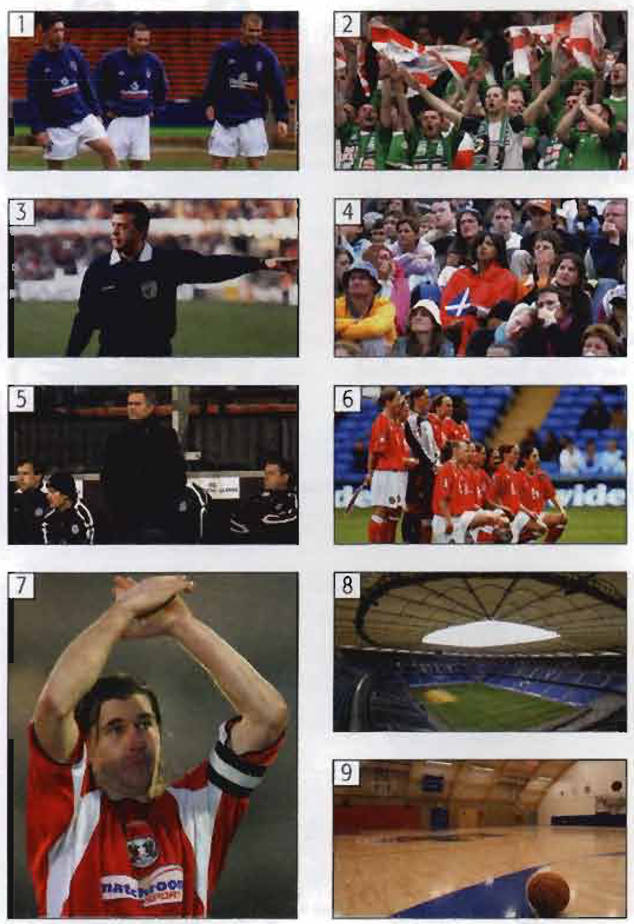
1. People and Places
Match the words and pictures.
___Captain/ ___Coach/ ___Fans/ ___Players/ ___ Referee
___ Spectators/ ___ Team/ ___ Stadium/ ___ Sports hall
7
5
2
1
3
4
6
8
9

Slide 14
Match the places and sports.
circuit court course pitch pool track
1. tennis / basketball ____
2. football / rugby / hockey ____
3. swimming / diving ____
4. athletics ____
5. Formula 1 / motorcycling ____
6. Golf ____
court
pitch
pool
track
circuit
court

Slide 15
Exercise: Read the definitions and write the words.
1. the people who watch a sport
2. the person who is the leader of a team
3. the person who is in charge of a team
4. what players do before they start playing
5. if you do a lot of exercise, you will get
6. the place where you play tennis
7. the person who controls e.g. a football match
8. the place where you ski
9. what professional sports people have to do every day
10. the place where athletes run athletics
spectators
captain
coach
warm up
fit
tennis court
referee
ski slope
train
track

Slide 16
Unit 1
Part B
3 READING

Slide 17
Complete the article with sentences A-F below.
For some people the pain of saying goodbye never leaves them.
Others can't resist the chance of one last pay day’.
Some sportspeople go on playing too long.
But for the lucky few, retirement can mean a successful new career.
Retirement for people in general is traumatic.
One of the-hardest things for any sports person to do is to know when to retire.
When you hear the final whistle
1/F One of the-hardest things for any sports person to do is to know when to retire. Do you retire when you are at your physical 'peak' or do you wait until your body (or your coach) tells you that it’s time to go? But even harder is finding the answer to the question 'What am I going to do with the rest of my life?’

Slide 18
For some people the pain of saying goodbye never leaves them.
Others can't resist the chance of one last pay day’.
Some sportspeople go on playing too long.
But for the lucky few, retirement can mean a successful new career.
Retirement for people in general is traumatic.
One of the-hardest things for any sports person to do is to know when to retire.
2/___ ‘There is a high risk of depression and people often find adjusting to a new way of life difficult’, says Ian Cockerill, a sports psychologist. 'For sportspeople, there's an extra trauma - the loss of status, the loss of recognition, and the loss of the glamour. That’s the hardest part.’ As Eddie Acaro, the US jockey says, ‘when a jockey retires, he becomes just another little man.’
E

Slide 19
For some people the pain of saying goodbye never leaves them.
Others can't resist the chance of one last pay day’.
Some sportspeople go on playing too long.
But for the lucky few, retirement can mean a successful new career.
Retirement for people in general is traumatic.
One of the-hardest things for any sports person to do is to know when to retire.
3/___ Perhaps they just can't stand life without the 'high' of playing professional sport. Michael Jordan, the greatest basketball player of all time, retired three times. He retired once from the Chicago Bulls, made a successful comeback with the Bulls, then retired again. His second comeback with an inferior team ended in failure and he retired forever at the age of 38 Jordan said, 'There will never be anything I do that will fulfil me as much as competing did.'
C

Slide 20
For some people the pain of saying goodbye never leaves them.
Others can't resist the chance of one last pay day’.
Some sportspeople go on playing too long.
But for the lucky few, retirement can mean a successful new career.
Retirement for people in general is traumatic.
One of the-hardest things for any sports person to do is to know when to retire.
4/___ Muhammad Ali needed the money, but his comeback fight, at the age of 39, against Trevor Berbick, was one of the saddest spectacles in modern sport. After losing to Berbick, Ali retired permanently. Three years later he developed Parkinson’s disease.
B

Slide 21
For some people the pain of saying goodbye never leaves them.
Others can't resist the chance of one last pay day’.
Some sportspeople go on playing too long.
But for the lucky few, retirement can mean a successful new career.
Retirement for people in general is traumatic.
One of the-hardest things for any sports person to do is to know when to retire.
5/___ As Jimmy Greaves, an ex-England international footballer said, ‘I think that a lot of players would prefer to be shot once their career is over.' Many of them spend their retirement in a continual battle against depression, alcohol, or drugs.
A

Slide 22
For some people the pain of saying goodbye never leaves them.
Others can't resist the chance of one last pay day’.
Some sportspeople go on playing too long.
But for the lucky few, retirement can mean a successful new career.
Retirement for people in general is traumatic.
One of the-hardest things for any sports person to do is to know when to retire.
6/___ Franz Beckenbauer is a classic example of a footballer who won everything with his club, Bayern Munich. After retiring he became a successful coach with Bayern and finally president of the club. John McEnroe, the infamous bad boy’ of tennis, is now a highly respected and highly paid TV commentator. But sadly, for most sportspeople these cases are the exceptions.
D

Slide 23
Can you remember these words?
adjective: depressed noun: depression
adjective: glamorous noun:
verb: lose noun:
verb: recognize noun:
verb: fail noun:
verb: retire noun:
glamour
loss
recognition
failure
retirement

Slide 24
{{ Thank You }}

